Slide 1
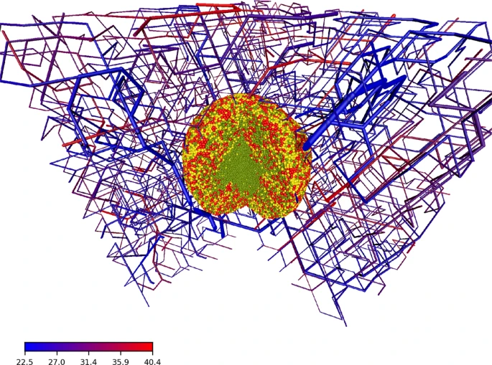

3D TME Software
UBC iGEM - May 2021
Notes:
Visualization shows tumor spheroid (red, yellow, green represent different cell cycle phases -> green necrotic core) within blood vessel network

Slide 2
Resources used
Code:
https://github.com/thierry3000/tumorcode and https://github.com/thierry3000/VBL
Instructions on how to set-up, run simulations, and visualize outputs:
https://www.biorxiv.org/content/10.1101/216903v2.supplementary-material
https://github.com/thierry3000/tumorcode/wiki
Ben’s set-up screencast (in Slack dry-lab channel) and document
Papers:
Fine-grained simulations of the microenvironment of vascularized tumours
Simulation of vascularized tumor growth, drug delivery, and oxygenation

Slide 3
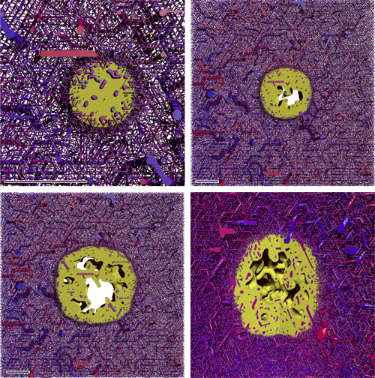
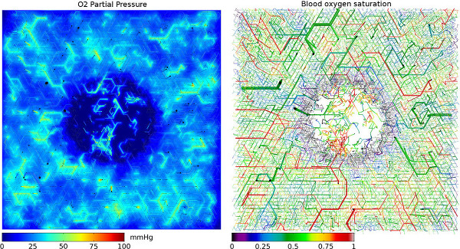
Overview: Simulated aspects of the TME
Dynamic blood vessel network
Multicellular tumor spheroid growth
Oxygen distribution
Interstitial fluid pressure
[Drug] distribution
Notes:
Right image shows growing multicellular tumor spheroid (including necrotic regions as void spaces) and dynamic vasculature, represented by a network of interconnected blood perfused pipes/cylinders, color coded by pressure. Vessel segments are dynamically created and deleted, and properties like radius change, over time.
Left image shows the oxygenation in a simulated vascular network (a slice through the center of a 3D simulation box). Left side shows oxygen partial pressure in tissue (note: hypoxic region).

Slide 4
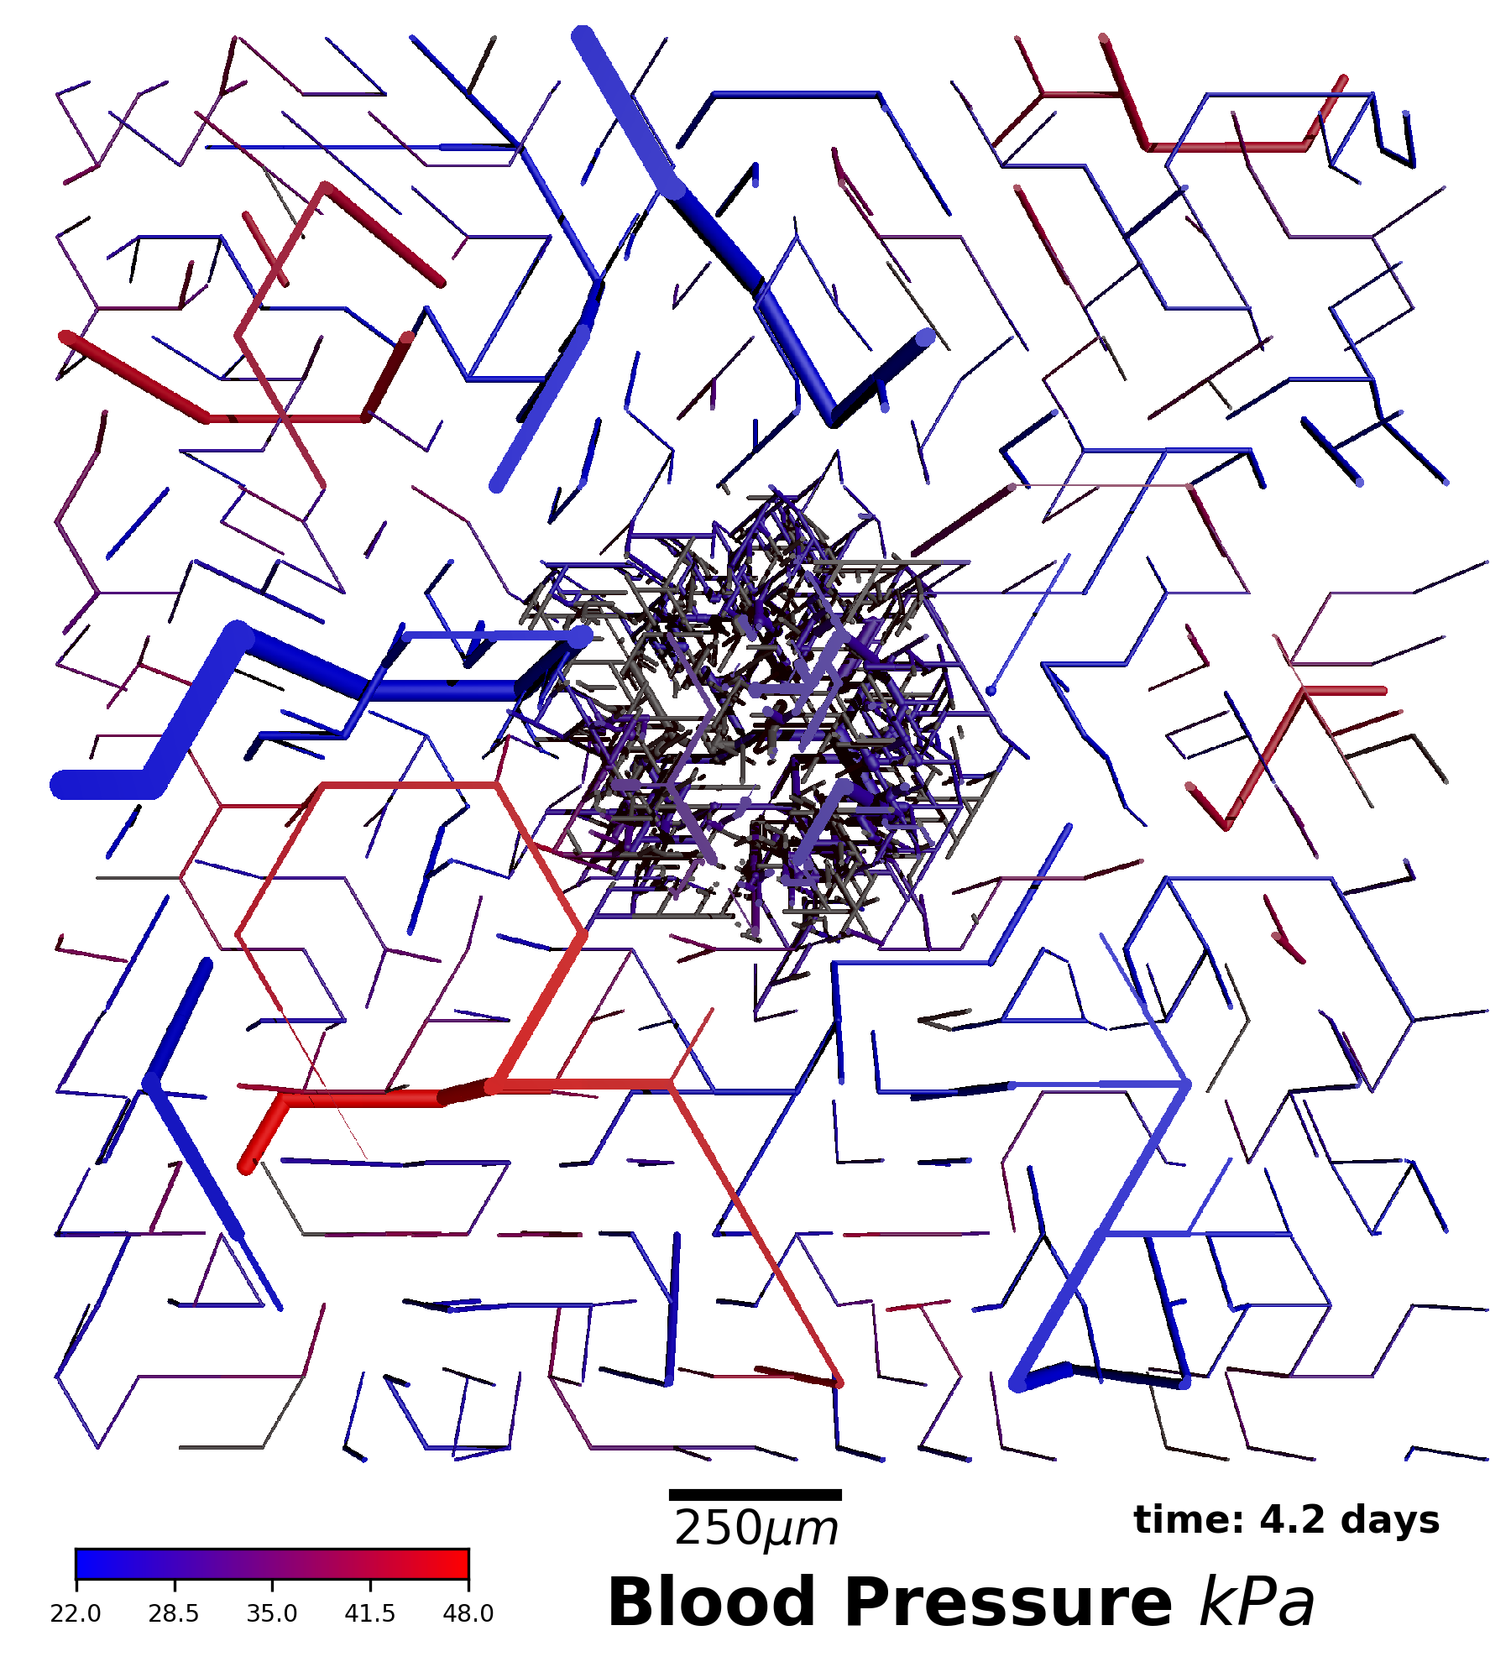
Vessels are color coded by blood pressure, where red is highest (arteries) and blue is lowest (veins).
During the simulation, the construction algorithm grows and shrinks arterial and venous trees depending on blood flow.
4.2 days - took this amount of time from seeding the tumor to generate this blood vessel network in the simulation

Slide 5
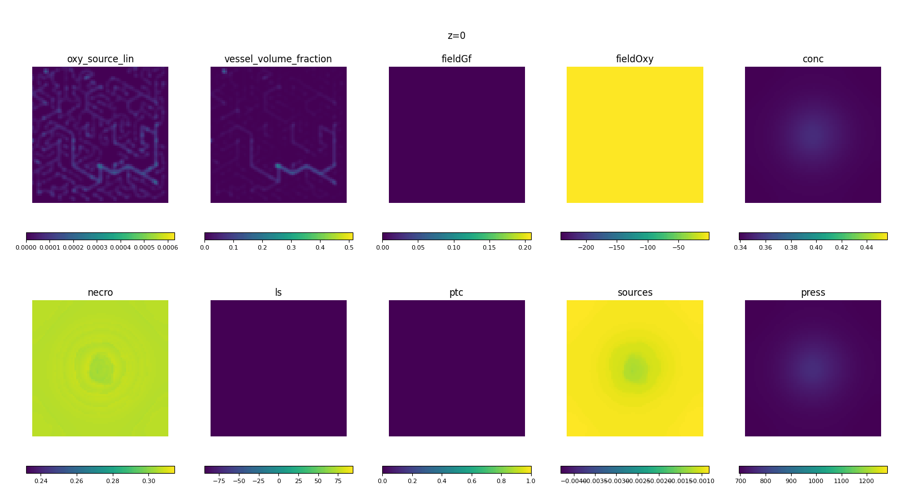
Notes:
2D slices from the 3D model along the z-axis at one particular timestep in the simulation
Ben’s code to generate similar animations: https://github.com/bnwlkr/iGEM

Slide 6
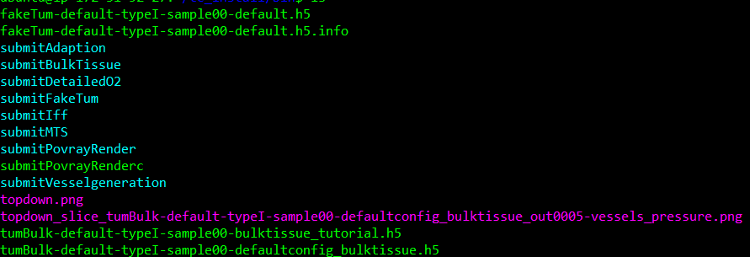
Simulation Scripts
program that simulates tumor growth (w/ or w/o vessels)
create fake tumor (cells grow as an expanding sphere at constant speed)
program to compute interstitial fluid flow & drug distribution
program to visualize data from simulations (generate image files)
program to create blood vessel network
data/results from simulations
Customize by specifying different parameter set name upon launching simulation:
https://github.com/thierry3000/tumorcode/tree/master/py/krebsjobs/parameters
https://github.com/thierry3000/tumorcode/wiki/Tutorial-A---simulation
https://github.com/thierry3000/tumorcode/wiki/Tutorial-B---visualization (POV-Ray vs. ParaView)

Slide 7
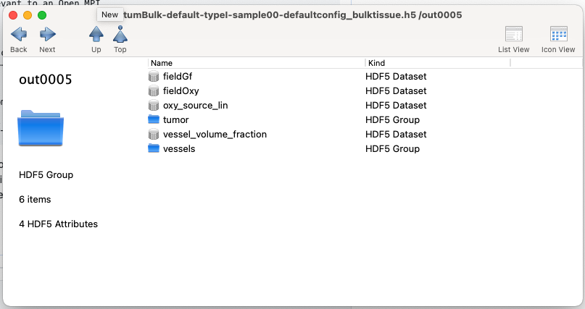
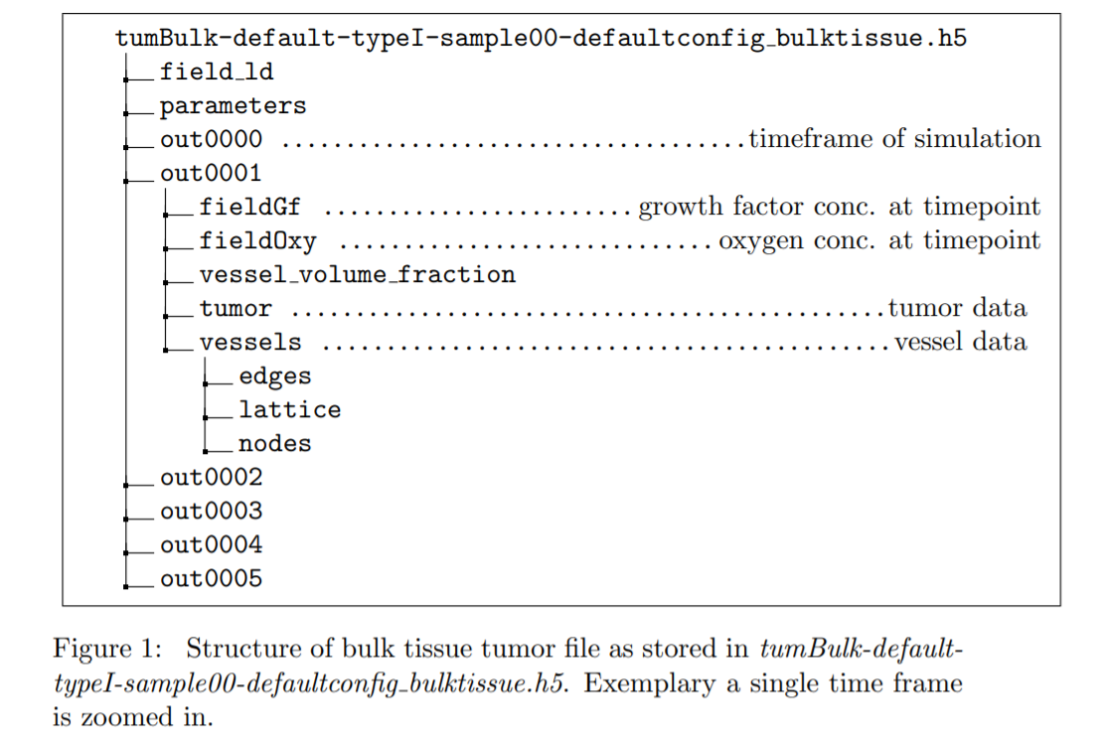
from supplementary material --->

Slide 8
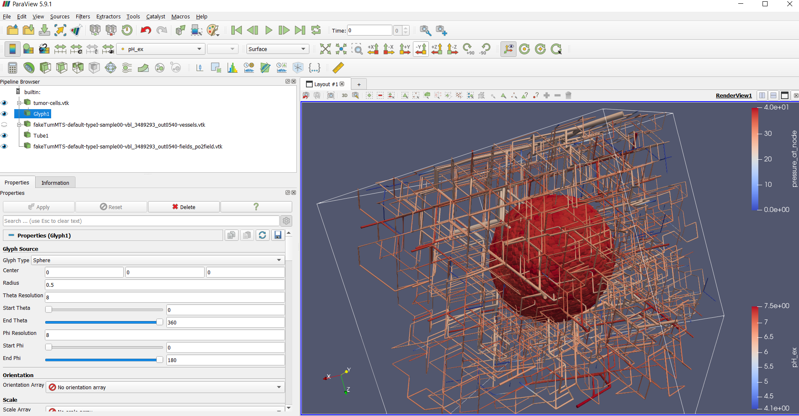
ParaView Visualizations (example)

Slide 9
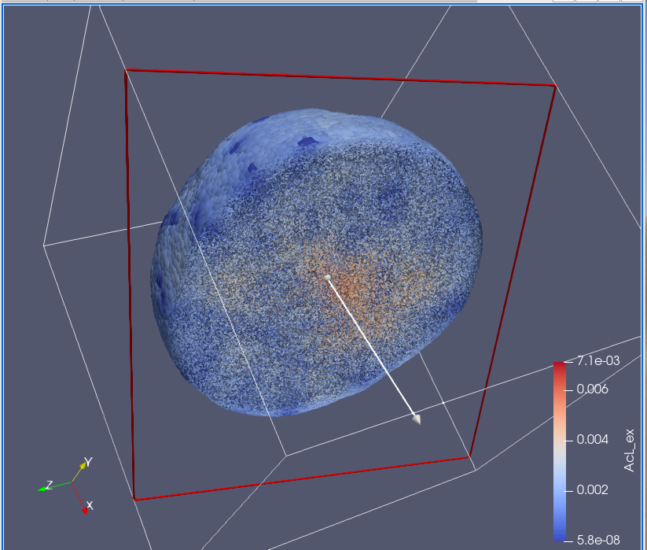
ParaView Visualizations (example)
Notes:
Tumor spheroid slice at final time frame of simulation; color scale - AcL_ex represents extracellular lactic acid (in terms of mass, picograms here)

Slide 10
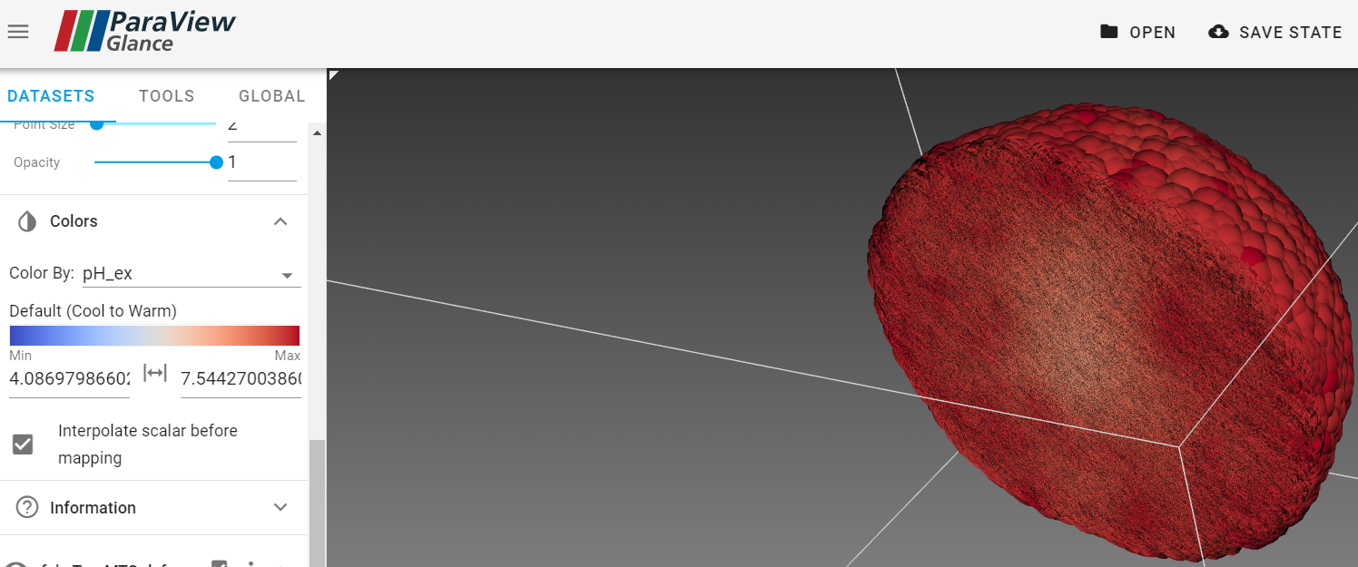
ParaView Visualizations (example)

Slide 11
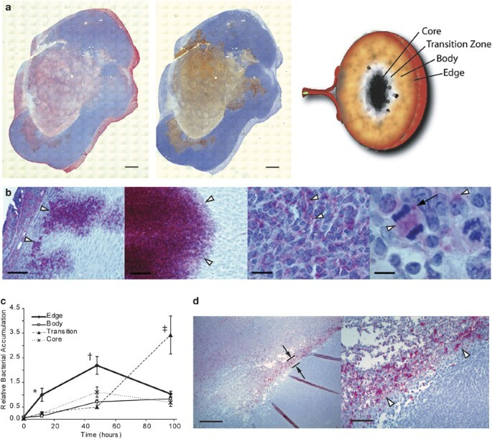
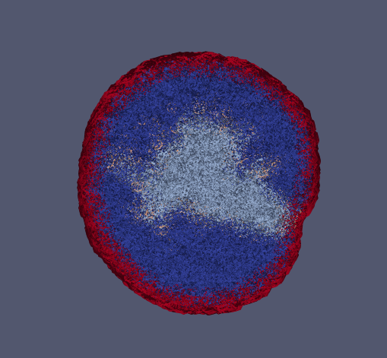
In progress: modelling Salmonella localization in different regions of the tumor spheroid

